Slide 1
National Road Research Alliance
Strategic Implementation Through Cooperative Pavement Research
Membership Structure and Roles

Slide 2
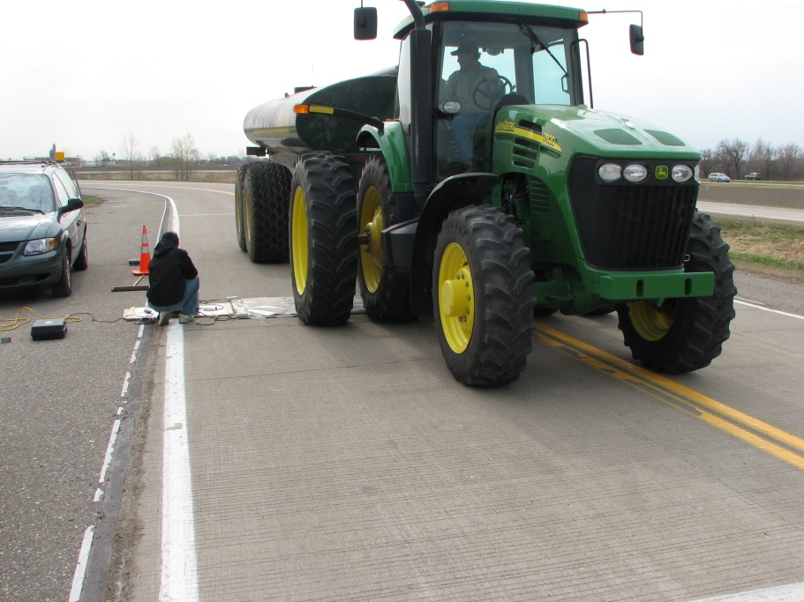
Mission
Primary Emphasis Areas
Local and State Sponsored Research
Implementation Focus
Technology Transfer
Training

Slide 3
Structure
Governing Board
Sets goals and mission
Executive Committee
Sets research objectives, goals and project selection
Associates
Provide innovative solutions to the State and Local identified research problem statements
Academia
Provide input on new technology and complete research projects

Slide 4
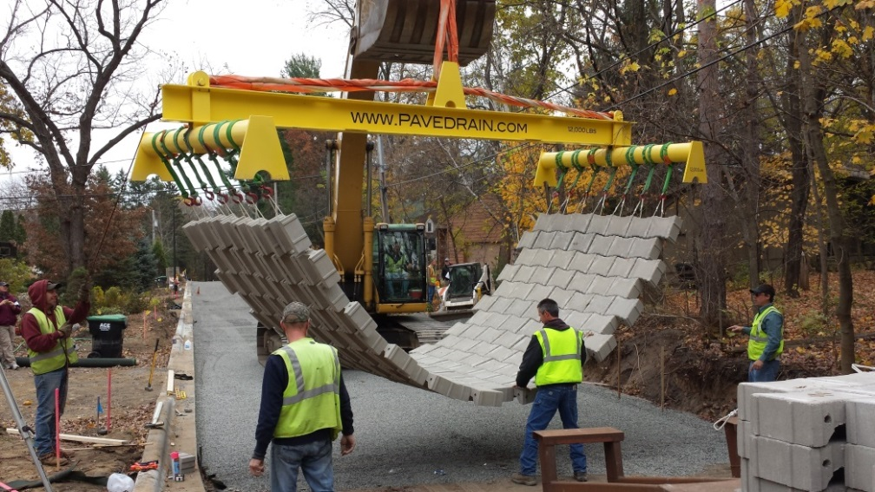
Governing Board
Board Members
Three Minnesota Local Road Research Board members representing local agencies
Three MnDOT members

Slide 5
Governing Board
Set overall direction
Establish goals
Insure member needs are met
Seek input from other groups
Attract new members
Attract new funding
Re-evaluate as needed
Establish and maintain good communication methods and procedures
Insure collaboration

Slide 6
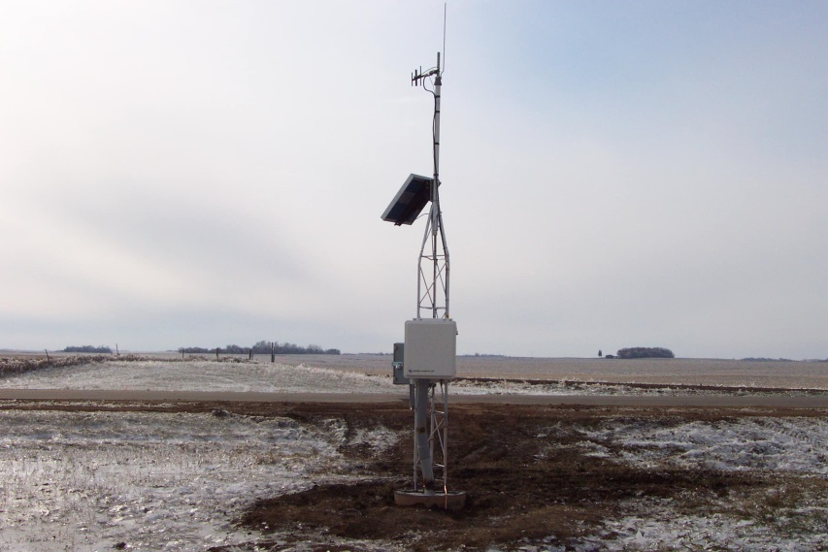
Executive Committee
Executive Committee Membership
Major sponsors that contribute $150,000 per year for 3 years.
Governing Board

Slide 7
Executive Committee
Set research objectives
Select projects for Phase 3 at MnROAD, summer 2017 construction planned
Define scope
Select project teams
Set project budgets and timelines
Insure a collaborative process with all members
Include training, tech transfer and implementation as a part of each project
Work as a team

Slide 8
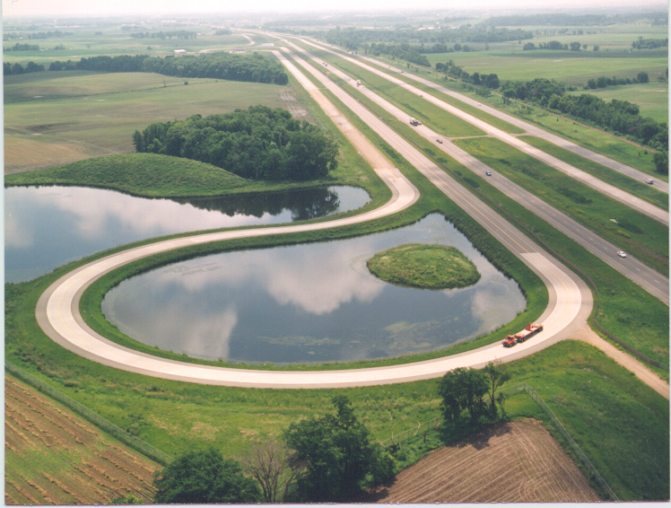
What do I get for $450,000?
Make decisions on $2.5 million construction funding at MnROAD
12,724 ft, 2 lanes available
More test sections
Instrumentation
Intelligent Compaction
Meeting/conference travel
MnROAD, NCAT, TRB, FPP, etc.
Student sponsor
Training development
Tech Transfer
Newsletters
Webinars
Implementation Series
Open House
Research contracts

Slide 9
Associates
Industry, consultants, suppliers, manufacturers, etc.
$2,000 per year for 3 years
Provide innovative solutions
Make your voice heard
Be an active member of a project team
Work with other non-members in your area
Encourage participation from others
Assist in the implementation of results to other industry members

Slide 10
Academia
$2,000 per year for 3 years
Future Vision - Provide input on new and future technology trends
Assist in the development of research projects
Participate in topic subcommittees
Provide a part-time student worker to assist in common research topics developed by the group
Develop and Complete research projects

Slide 11
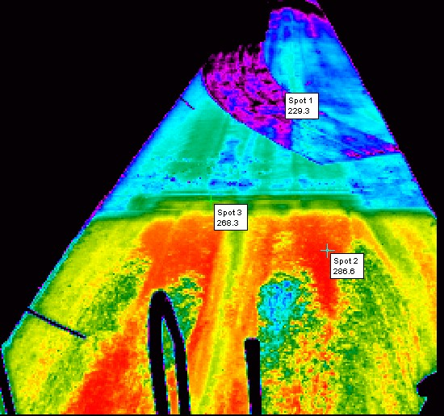
Project Teams
Research Project Teams
Chaired by Executive Member
Associate and Academic membership
Make decisions on $2.5 million construction funding at MnROAD
Design the experiment through implementation
Tech Transfer Team
Chaired by Executive Member
Associate and Academic membership
Newsletters
Webinars
Training
Implementation Series
Select shovel ready technologies
Pavement Conference/NCAT Conference
All members meeting prior to conferences

Slide 12
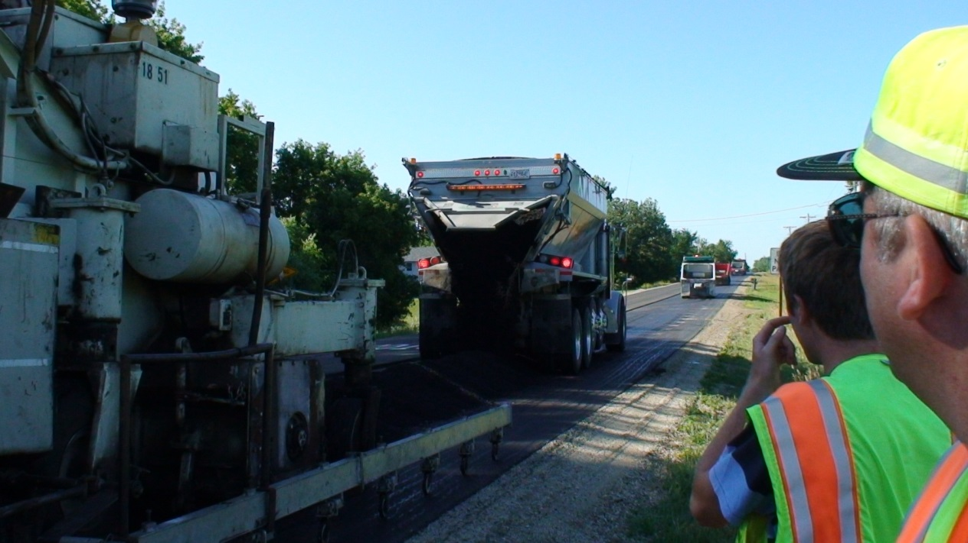
Project Teams
Communications Team
Chaired by Executive Member
Associate and Academic membership
Newsletters
Web site
Outreach

Slide 13
Schedule
NRRA starts Fall 2015
MnROAD Phase 3
Planning – currently underway
Design – 2016
Construction – 2017
In current STIP
$2.5 million
Work concurrently with NCAT Partnership

Slide 14
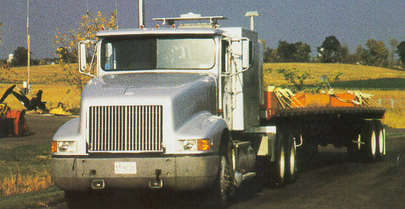
Thank you for your interest in joining the NRRA!

