Slide 1
Rehabilitation Designs with AC Overlays

Slide 2
PaveME Asphalt Overlay Design Options
Existing AC Pavement
Flexible
Semi-rigid
Existing Fractured PCC Pavement
Crack and seat
Break and seat
Existing Intact PCC Pavement
JPCP and CRCP
Composite pavements
Rubblization
Previously AC overlaid pavements
Others
Seal coat over existing AC pavement
Overlay with interlayer

Slide 3
Asphalt Overlay of Existing Asphalt Pavement
Based on information provided by Virginia DOT

Slide 4
Project Description
Highway type
Rural Interstate
4-lane divided
Modifications
Original v2.2
Training v2.6.0
Climate location
Global calibration
Source: Google

Slide 5
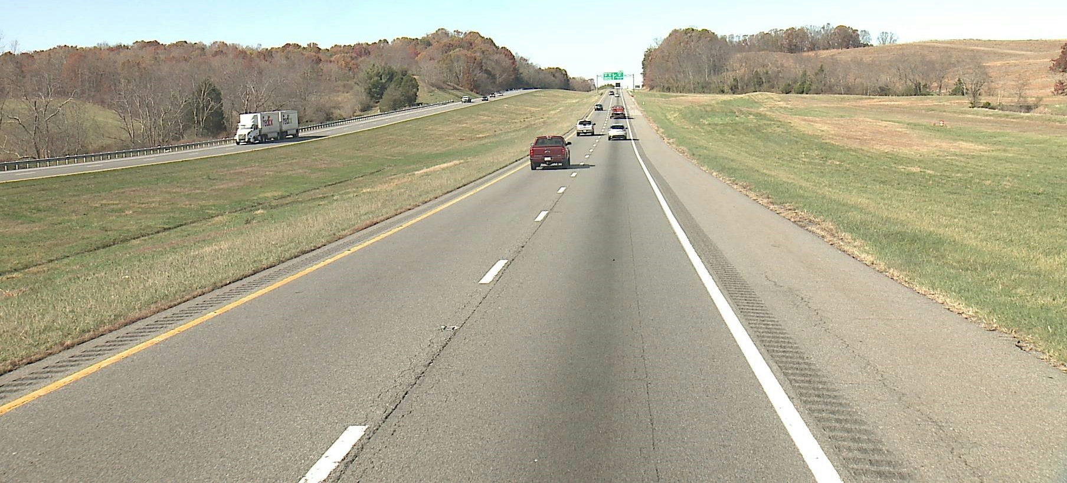
Typical Road Configuration
Source: Virginia DOT

Slide 6
Distress prior to Overlay

Slide 7
Distress prior to Overlay

Slide 8
PaveME Inputs – General Information
AC Overlay
12” Existing AC
8” Aggregate Base
6” Fill Material (CBR = 30)
Subgrade (A-7-6)

Slide 9
PaveME Inputs – Performance Criteria

Slide 10
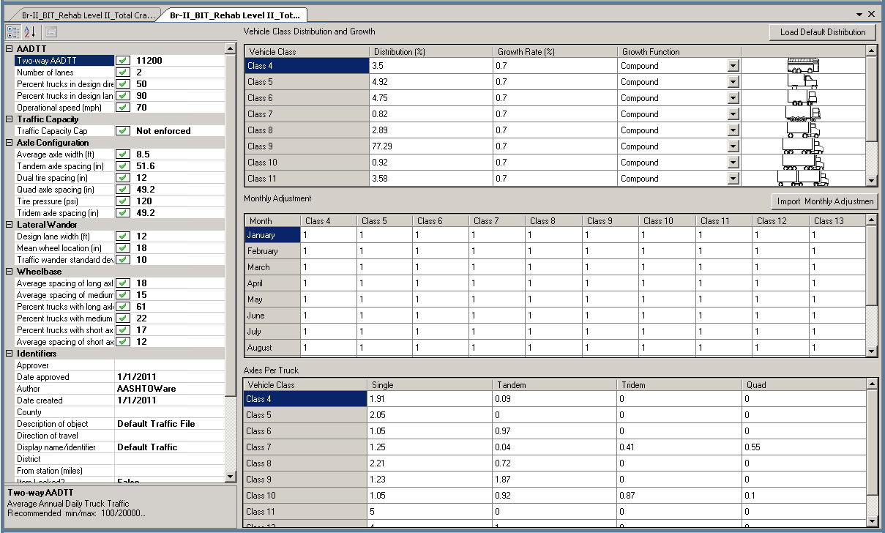
PaveME Inputs – Traffic

Slide 11
PaveME Inputs – Traffic (continued…)

Slide 12
PaveME Inputs – Traffic (continued…)

Slide 13
PaveME Inputs – Traffic (continued…)

Slide 14
PaveME Inputs – Traffic (continued…)

Slide 15
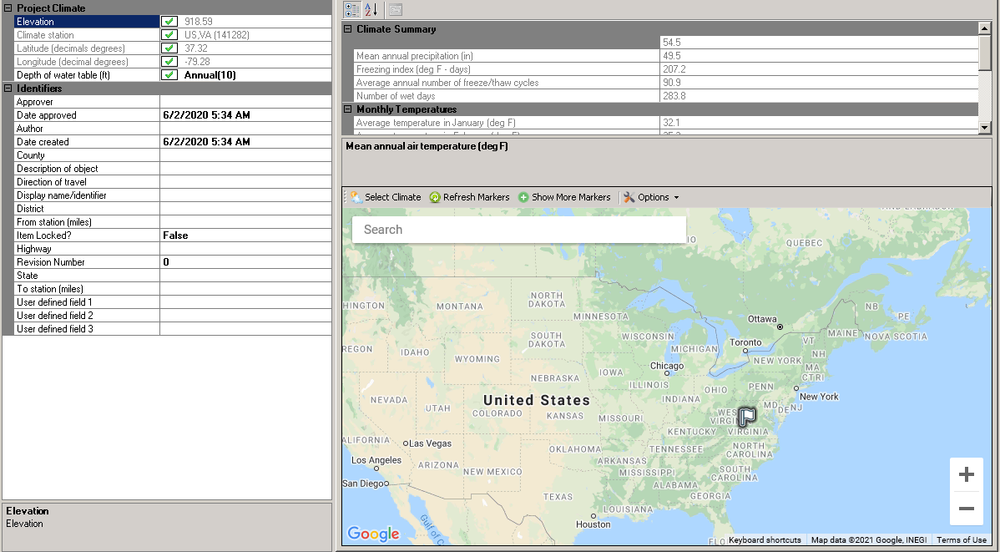
PaveME Inputs – Climate

Slide 16
AC Layer Properties

Slide 17
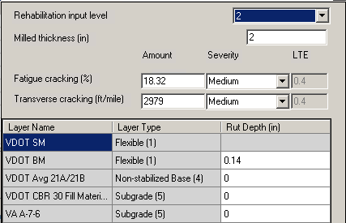
Rehabilitation Inputs

Slide 18
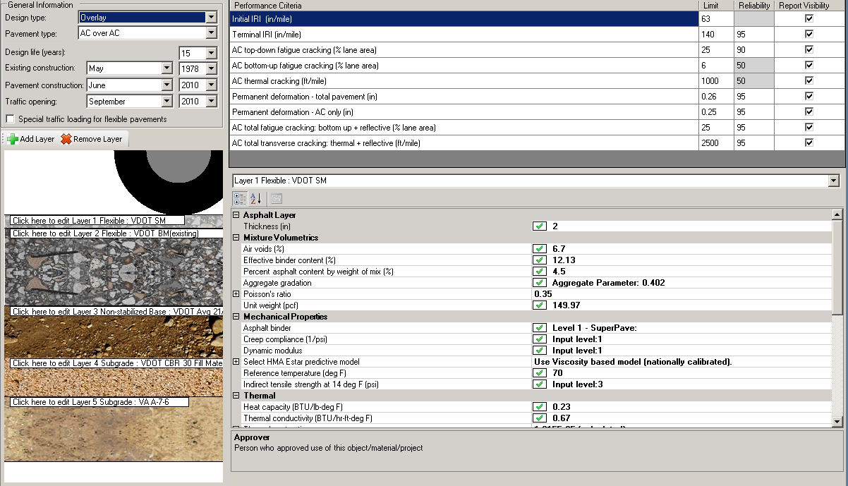
AC Layer Properties
Double click

Slide 19
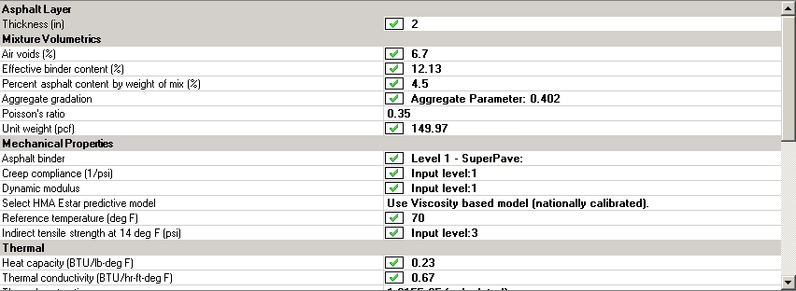
AC Layer Properties

Slide 20
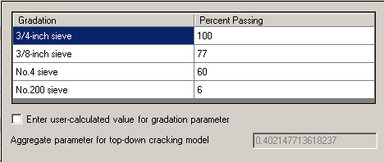
AC Layer Properties (continued…)

Slide 21
AC Layer Properties (continued…)

Slide 22
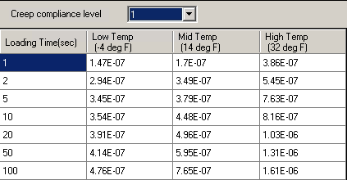
AC Layer Properties (continued…)

Slide 23
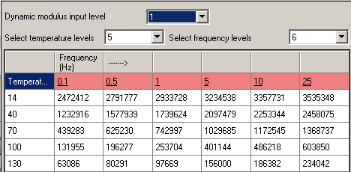
AC Layer Properties (continued…)

Slide 24
AC Layer Properties (continued…)

Slide 25
Summary of AC Layer Properties
Layer | Thickness (inch) | Mixture Volumetrics | Mechanical Properties | Thermal
Overlay | 2 | Air voids: 6.7% Eff. Binder: 12.13% % asphalt: 4.5 Poisson’s ratio: 0.35 Unit weight: 150 pcf | Binder: Level 1 Superpave Creep: Level 1 Dynamic modulus: Level 1 Viscosity model Ref temp: 70°F Indirect tensile: Level 3 | Heat capacity: default Thermal conductivity: default Thermal contraction: calculated
Existing | 12 | Air voids: 6.3% Eff. Binder: 9.82% Poisson’s ratio: 0.35 Unit weight: 151 pcf | Binder: Superpave 64-22 Dynamic modulus: Level 3 Viscosity model Ref temp: 70°F | Heat capacity: default Thermal conductivity: default Thermal contraction: calculated

Slide 26
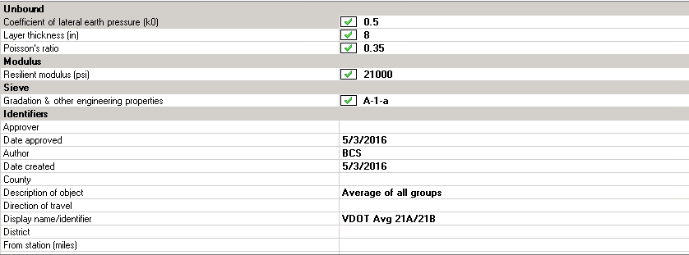
Base and Subgrade Layer Properties

Slide 27
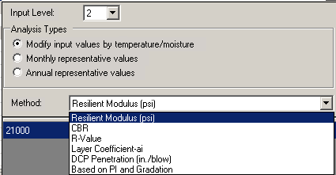
Base and Subgrade Layer Properties

Slide 28
Base and Subgrade Layer Properties

Slide 29
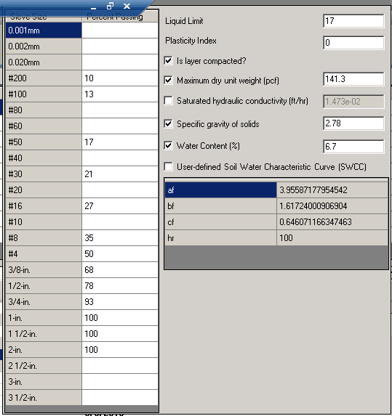
Base and Subgrade Layer Properties

Slide 30
Summary of Unbound Layer Properties
Layer | Thickness (inch) | Unbound | Modulus | Sieve
Non-Stabilized Base | 8 | Coef. Lateral earth pressure: 0.5 Poisson’s ratio: 0.35 | 21,000 psi | A-1-a
Fill Material | 6 | Coef. Lateral earth pressure: 0.5 Poisson’s ratio: 0.35 | 13,500 psi | A-2-4
Subgrade | Semi-infinite | Coef. Lateral earth pressure: 0.5 Poisson’s ratio: 0.35 | 14,000 psi | A-7-6

Slide 31
Design Structure

Slide 32
Evaluation Scenarios
DOT Evaluation
2.0-inch overlay
2.0-inch mill
Overlay thickness
No milling
Mill and fill
Asphalt Binder (Level 3)
PG 58-22
PG 64-22
PG 70-22

Slide 33
Comparison – Mill, Fill, and Overlay
Condition | Target | 2” Overlay, No Milling
IRI (in/mi) | 140 | 176 | 72%
AC rutting (inch) | 0.25 | 0.11 | 100%
Total rut (inch) | 0.26 | 0.24 | 98%
Bottom-up cracking (%) | 6 | 0 | 100%
Top-down cracking (%) | 25 | 13 | 100%
Bottom-up + reflective (%) | 25 | 36 | 0%
Thermal cracking (ft/mi) | 1000 | 1 | 100%
Thermal + reflective (ft/mi) | 2500 | 2400 | 100%
Reliability = 95% for all conditions, except bottom-up fatigue cracking and thermal cracking = 50%

Slide 34
Comparison – Mill, Fill, and Overlay (continued…)
Condition | Target | 2” Overlay, No Milling |  | 2” Mill and Overlay
IRI (in/mi) | 140 | 176 | 72% | 171 | 76%
AC rutting (inch) | 0.25 | 0.11 | 100% | 0.12 | 100%
Total rut (inch) | 0.26 | 0.24 | 98% | 0.24 | 98%
Bottom-up cracking (%) | 6 | 0 | 100% | 0 | 100%
Top-down cracking (%) | 25 | 13 | 100% | 13 | 100%
Bottom-up + reflective (%) | 25 | 36 | 0% | 28 | 25%
Thermal cracking (ft/mi) | 1000 | 1 | 100% | 1 | 100%
Thermal + reflective (ft/mi) | 2500 | 2400 | 100% | 2400 | 100%
Reliability = 95% for all conditions, except bottom-up fatigue cracking and thermal cracking = 50%

Slide 35
Comparison – Mill, Fill, and Overlay (continued…)
Condition | Target | 2” Overlay, No Milling |  | 2” Mill and Overlay |  | 2” Mill and Fill 2” Overlay
IRI (in/mi) | 140 | 176 | 72% | 171 | 76% | 171 | 76%
AC rutting (inch) | 0.25 | 0.11 | 100% | 0.12 | 100% | 0.12 | 100%
Total rut (inch) | 0.26 | 0.24 | 98% | 0.24 | 98% | 0.24 | 98%
Bottom-up cracking (%) | 6 | 0 | 100% | 0 | 100% | 0 | 100%
Top-down cracking (%) | 25 | 13 | 100% | 13 | 100% | 13 | 100%
Bottom-up + reflective (%) | 25 | 36 | 0% | 28 | 25% | 28 | 25%
Thermal cracking (ft/mi) | 1000 | 1 | 100% | 1 | 100% | 1 | 100%
Thermal + reflective (ft/mi) | 2500 | 2400 | 100% | 2400 | 100% | 2400 | 100%
Reliability = 95% for all conditions, except bottom-up fatigue cracking and thermal cracking = 50%

Slide 36
Comparison – Mill, Fill, and Overlay (continued…)
Condition | Target | 2” Overlay, No Milling |  | 2” Mill and Overlay |  | 2” Mill and Fill 2” Overlay |  | 2” Mill and Fill 4” Overlay
IRI (in/mi) | 140 | 176 | 72% | 171 | 76% | 171 | 76% | 167 | 78%
AC rutting (inch) | 0.25 | 0.11 | 100% | 0.12 | 100% | 0.12 | 100% | 0.13 | 100%
Total rut (inch) | 0.26 | 0.24 | 98% | 0.24 | 98% | 0.24 | 98% | 0.24 | 98%
Bottom-up cracking (%) | 6 | 0 | 100% | 0 | 100% | 0 | 100% | 0 | 100%
Top-down cracking (%) | 25 | 13 | 100% | 13 | 100% | 13 | 100% | 13 | 100%
Bottom-up + reflective (%) | 25 | 36 | 0% | 28 | 25% | 28 | 25% | 23 | 100%
Thermal cracking (ft/mi) | 1000 | 1 | 100% | 1 | 100% | 1 | 100% | 1 | 100%
Thermal + reflective (ft/mi) | 2500 | 2400 | 100% | 2400 | 100% | 2400 | 100% | 2400 | 100%
Reliability = 95% for all conditions, except bottom-up fatigue cracking and thermal cracking = 50%

Slide 37
Mill vs No Mill
“…test sections used to globally calibrate the reflection cracking transfer function did not exhibit any consistent difference between the use of seal coats or interlayers, milling and overlay, or just a simple overlay…Local calibration is recommended for those agencies that have observed increases in service life or reduced reflection cracking…” (MOP 2020)

Slide 38
Comparison – PG Binder Grade
Condition | Target | PG 58-22
IRI (in/mi) | 140 | 185 | 64%
AC rutting (inch) | 0.25 | 0.23 | 97%
Total rut (inch) | 0.26 | 0.36 | 52%
Bottom-up cracking (%) | 6 | 0 | 100%
Top-down cracking (%) | 25 | 13 | 100%
Bottom-up + reflective (%) | 25 | 45 | 0%
Thermal cracking (ft/mi) | 1000 | 1 | 100%
Thermal + reflective (ft/mi) | 2500 | 2400 | 100%
Reliability = 95% for all conditions, except bottom-up fatigue cracking and thermal cracking = 50%

Slide 39
Comparison – PG Binder Grade (continued…)
Condition | Target | PG 58-22 |  | PG 64-22
IRI (in/mi) | 140 | 185 | 64% | 183 | 66%
AC rutting (inch) | 0.25 | 0.23 | 97% | 0.20 | 95%
Total rut (inch) | 0.26 | 0.36 | 52% | 0.33 | 70%
Bottom-up cracking (%) | 6 | 0 | 100% | 0 | 100%
Top-down cracking (%) | 25 | 13 | 100% | 13 | 100%
Bottom-up + reflective (%) | 25 | 45 | 0% | 44 | 0%
Thermal cracking (ft/mi) | 1000 | 1 | 100% | 1 | 100%
Thermal + reflective (ft/mi) | 2500 | 2400 | 100% | 2400 | 100%
Reliability = 95% for all conditions, except bottom-up fatigue cracking and thermal cracking = 50%

Slide 40
Comparison – PG Binder Grade (continued…)
Condition | Target | PG 58-22 |  | PG 64-22 |  | PG 70-22
IRI (in/mi) | 140 | 185 | 64% | 183 | 66% | 182 | 67%
AC rutting (inch) | 0.25 | 0.23 | 97% | 0.20 | 95% | 0.17 | 100%
Total rut (inch) | 0.26 | 0.36 | 52% | 0.33 | 70% | 0.30 | 81%
Bottom-up cracking (%) | 6 | 0 | 100% | 0 | 100% | 0 | 100%
Top-down cracking (%) | 25 | 13 | 100% | 13 | 100% | 13 | 100%
Bottom-up + reflective (%) | 25 | 45 | 0% | 44 | 0% | 43 | 0%
Thermal cracking (ft/mi) | 1000 | 1 | 100% | 1 | 100% | 1 | 100%
Thermal + reflective (ft/mi) | 2500 | 2400 | 100% | 2400 | 100% | 2400 | 100%
Reliability = 95% for all conditions, except bottom-up fatigue cracking and thermal cracking = 50%

Slide 41
QUESTIONS?

Slide 42
Asphalt Overlay of Existing Composite Pavement
Based on information provided by Michigan DOT

Slide 43
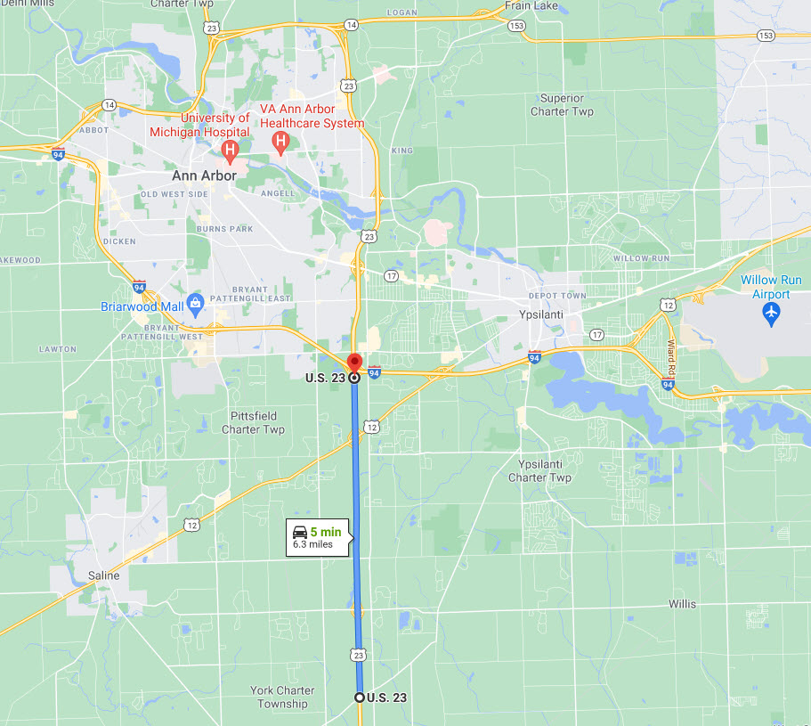
Project Description
Highway type
Urban
4-lane divided
Modifications
Original v2.3.0
Training v2.6.0
Climate location
Global calibration
Source: Google

Slide 44
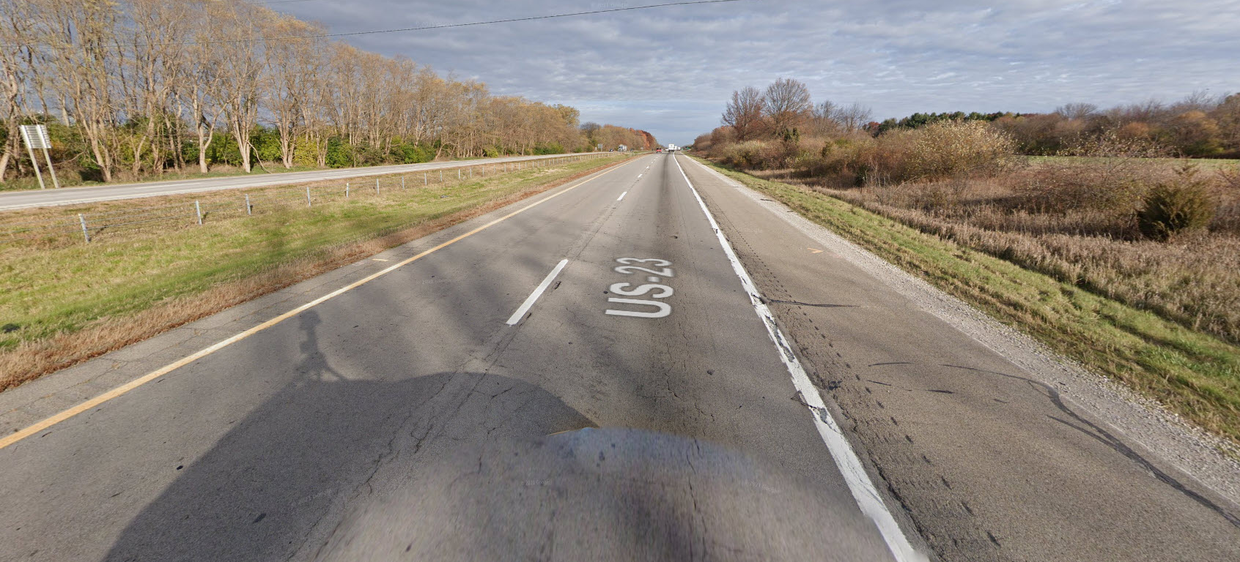
Pavement Condition Prior to Overlay
Source: Google

Slide 45
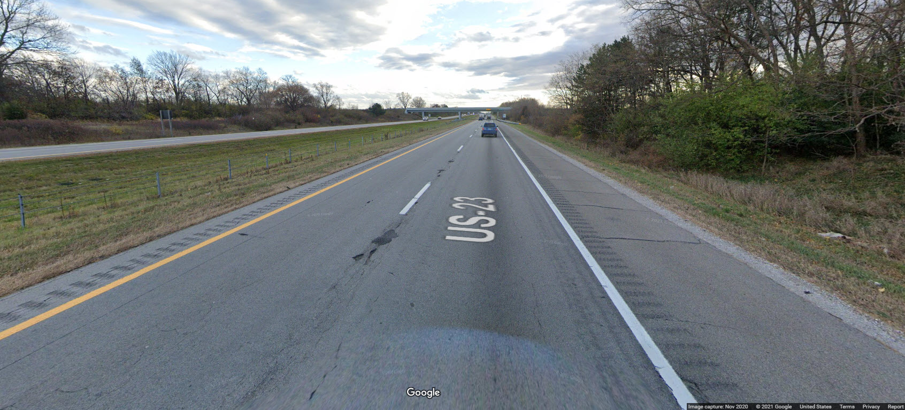
Pavement Condition Prior to Overlay (continued…)
Source: Google

Slide 46
Typical Distress (2019)
Milepost | Direction | Distress Index | IRI (in/mi) | Rut (in)
0.480 – 4.936 | I | 14 | 49 | 0.09
4.936 – 6.165 | I | 91 | 59 | 0.16
6.165 – 6.550 | I | 92 | 52 | 0.14
6.550 – 9.894 | I | 48 | 171 | 0.08
Weighted average |  | 39 | 94 | 0.10
Milepost | Direction | Distress Index | IRI (in/mi) | Rut (in)
3.309 – 6.168 | D | 32 | 52 | 0.26
6.169 – 6.400 | D | 34 | 53 | 0.25
6.400 – 9.905 | D | 42 | 106 | 0.10
Weighted average |  | 37 | 81 | 0.17

Slide 47
PaveME Inputs – Performance Criteria

Slide 48
PaveME Inputs – General Information
1.5” AC Overlay
2” AC Overlay
3” Existing AC
9” JPCP
4” Aggregate Base
10” Sand Subbase
Clay Subgrade (LL=33, PI=15)

Slide 49
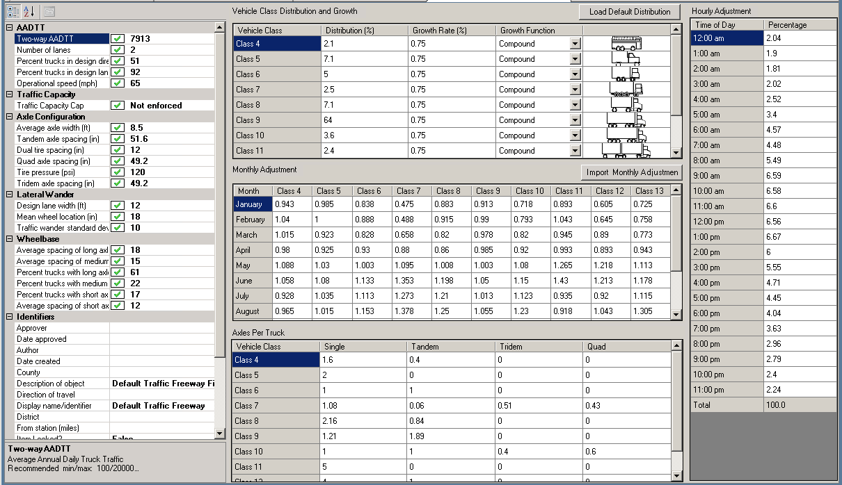
PaveME Inputs – Traffic

Slide 50
PaveME Inputs – Traffic (continued…)

Slide 51
PaveME Inputs – Traffic (continued…)

Slide 52
PaveME Inputs – Traffic (continued…)

Slide 53
PaveME Inputs – Traffic (continued…)

Slide 54
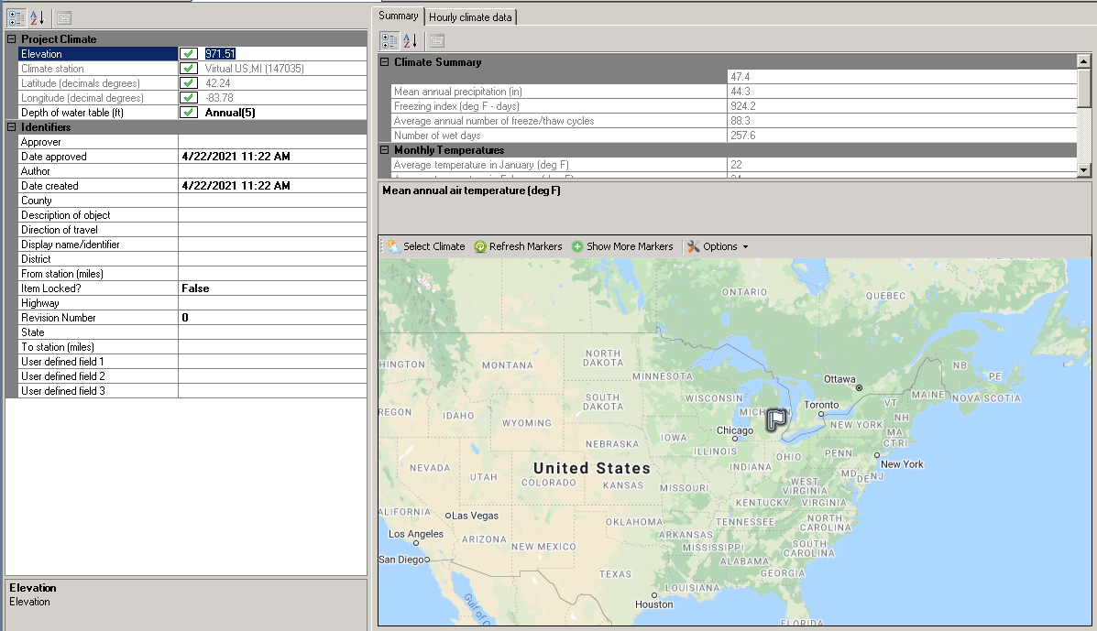
PaveME Inputs – Climate

Slide 55
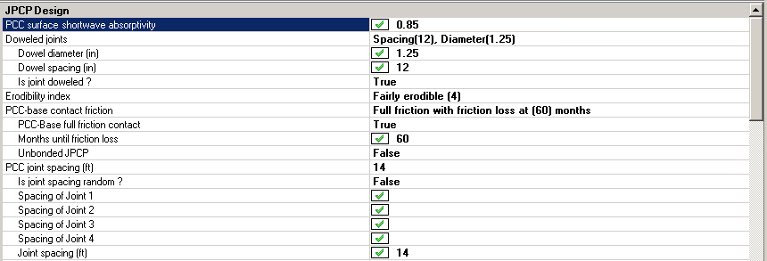
PaveME Inputs – JPCP Design Properties

Slide 56
PaveME Inputs – JPCP Design Properties

Slide 57
PaveME Inputs – JPCP Design Properties

Slide 58
PaveME Inputs – JPCP Design Properties

Slide 59
PaveME Inputs – JPCP Design Properties

Slide 60
PaveME Inputs – AC Layer Properties
Layer | Thickness (inch) | Mixture Volumetrics | Mechanical Properties | Thermal
Overlay | 1.5 | Air voids: 6% Eff. Binder: 12.6% % asphalt: 4.5 Poisson’s ratio: 0.35 Unit weight: 145.2 pcf | Binder: Level 1 PG 64-28 Creep: Level 1 Dynamic modulus: Level 1 Viscosity model Ref temp: 70°F Indirect tensile: Level 3 | Heat capacity: default Thermal conductivity: default Thermal contraction: calculated
Overlay | 2.0 | Air voids: 6.1% Eff. Binder: 11.5% Poisson’s ratio: 0.35 Unit weight: 146.4 pcf | Binder: Level 1 PG 64-28 Dynamic modulus: Level 1 Viscosity model Ref temp: 70°F | Heat capacity: default Thermal conductivity: default Thermal contraction: calculated
Existing | 3.0 | Air voids: 6.1% Eff. Binder: 11.5% Poisson’s ratio: 0.35 Unit weight: 146.4 pcf | Binder: Level 1 PG 70-28 Dynamic modulus: Level 1 Viscosity model Ref temp: 70°F | Heat capacity: default Thermal conductivity: default Thermal contraction: calculated

Slide 61
PaveME Inputs – Base Layers and Subgrade Properties
Layer | Thickness (inch) | Unbound | Modulus | Sieve
Non-Stabilized Base | 4 | Coef. Lateral earth pressure: 0.5 Poisson’s ratio: 0.35 | 33,000 psi | A-1-a
Sand Subbase | 10 | Coef. Lateral earth pressure: 0.5 Poisson’s ratio: 0.35 | 20,000 psi | A-1-b
Subgrade | Semi-infinite | Coef. Lateral earth pressure: 0.5 Poisson’s ratio: 0.35 | 5,000 psi | A-7-6

Slide 62
Design Structure

Slide 63
Evaluation Scenarios
DOT Evaluation
1.5-inch PG64-28 + 2.0-inch PG64-28 (2 layers)
10% distress slabs and 2% slabs replaced
Slab Repair
10% distress slabs and 0% slabs replaced
10% distress slabs and 10% slabs replaced
Overlay thickness
2.0-inch PG64-28 + 3.0-inch PG64-28 (2 layers)

Slide 64
Comparison – Slab Repair
Condition | Target | Reli-ability | 10% distressed / 0% repaired
IRI (in/mi) | 172 | 95 | 147 | 99%
AC rutting (inch) | 0.50 | 95 | 0.11 | 100%
Bottom-up cracking (% lane area) | 20 | 95 | 2 | 100%
Total transverse cracking (ft/mi) | 2500 | 95 | 7775 | 2%
Thermal cracking (ft/mi) | 1000 | 50 | 2112 | 0%
Top-down cracking (% lane area) | 25 | 90 | 14 | 100%
JPCP transverse cracking (% slabs) | 15 | 95 | 24 | 72%

Slide 65
Comparison – Slab Repair (continued…)
Condition | Target | Reli-ability | 10% distressed / 0% repaired |  | 10% distressed / 2% repaired
IRI (in/mi) | 172 | 95 | 147 | 99% | 147 | 99%
AC rutting (inch) | 0.50 | 95 | 0.11 | 100% | 0.1 | 100%
Bottom-up cracking (% lane area) | 20 | 95 | 2 | 100% | 2 | 100%
Total transverse cracking (ft/mi) | 2500 | 95 | 7775 | 2% | 7697 | 2%
Thermal cracking (ft/mi) | 1000 | 50 | 2112 | 0% | 2112 | 0%
Top-down cracking (% lane area) | 25 | 90 | 14 | 100% | 14 | 100%
JPCP transverse cracking (% slabs) | 15 | 95 | 24 | 72% | 21 | 81%

Slide 66
Comparison – Slab Repair (continued…)
Condition | Target | Reli-ability | 10% distressed / 0% repaired |  | 10% distressed / 2% repaired |  | 10% distressed / 10% repaired
IRI (in/mi) | 172 | 95 | 147 | 99% | 147 | 99% | 147 | 99%
AC rutting (inch) | 0.50 | 95 | 0.11 | 100% | 0.1 | 100% | 0.11 | 100%
Bottom-up cracking (% lane area) | 20 | 95 | 2 | 100% | 2 | 100% | 2 | 100%
Total transverse cracking (ft/mi) | 2500 | 95 | 7775 | 2% | 7697 | 2% | 7614 | 2%
Thermal cracking (ft/mi) | 1000 | 50 | 2112 | 0% | 2112 | 0% | 2112 | 0%
Top-down cracking (% lane area) | 25 | 90 | 14 | 100% | 14 | 100% | 14 | 100%
JPCP transverse cracking (% slabs) | 15 | 95 | 24 | 72% | 21 | 81% | 3 | 100%

Slide 67
Comparison – Overlay Thickness
Condition | Target | Reli-ability | 10% distressed / 10% repaired |  | 5-inch Overlay
IRI (in/mi) | 172 | 95 | 147 | 99% | 143 | 95%
AC rutting (inch) | 0.50 | 95 | 0.11 | 100% | 0.09 | 100%
Bottom-up cracking (% lane area) | 20 | 95 | 2 | 100% | 2 | 100%
Total transverse cracking (ft/mi) | 2500 | 95 | 7614 | 2% | 5681 | 12%
Thermal cracking (ft/mi) | 1000 | 50 | 2112 | 0% | 1964 | 0%
Top-down cracking (% lane area) | 25 | 90 | 14 | 100% | 90 | 100%
JPCP transverse cracking (% slabs) | 15 | 95 | 3 | 100% | 3 | 100%

Slide 68
Comparison – Overlay Thickness
Condition | Target | Reli-ability | 10% distressed / 10% repaired |  | 5-inch Overlay |  | 6-inch Overlay
IRI (in/mi) | 172 | 95 | 147 | 99% | 143 | 95% | 142 | 100%
AC rutting (inch) | 0.50 | 95 | 0.11 | 100% | 0.09 | 100% | 0.09 | 100%
Bottom-up cracking (% lane area) | 20 | 95 | 2 | 100% | 2 | 100% | 2 | 100%
Total transverse cracking (ft/mi) | 2500 | 95 | 7614 | 2% | 5681 | 12% | 5112 | 20%
Thermal cracking (ft/mi) | 1000 | 50 | 2112 | 0% | 1964 | 0% | 1742 | 0%
Top-down cracking (% lane area) | 25 | 90 | 14 | 100% | 14 | 100% | 14 | 100%
JPCP transverse cracking (% slabs) | 15 | 95 | 3 | 100% | 3 | 100% | 3 | 100%

Slide 69
QUESTIONS?

