Slide 1
Asphalt Overlay of Fractured JCPs
Presenter: Julie Vandenbossche
Lydia Peddicord – PennDOT
Tom Adams- Formerly with PennDOT
Greg Tomon – Lindy Paving (Site Photos)

Slide 2
PaveME Asphalt Overlay Design Options
Existing AC Pavement
Flexible
Semi-rigid
Existing Fractured PCC Pavement
Crack and seat
Break and seat
Existing Intact PCC Pavement
JPCP and CRCP
Composite pavements
Rubblization
Previously AC overlaid pavements
Others
Seal coat over existing AC pavement
Overlay with interlayer

Slide 3
Terminology
Crack/break and Seat -breaking the underlying PCC pavement into relatively small pieces (about 1 ft² to 2 ft²) by repeatedly dropping a large weight. The pieces are then seated.
Design: Overlay/AC over JPCP Fractured
Rubblization - reducing underlying PCC pavement to rubble (3 to 8 in). This rubble is then used as a high quality base course.
Design: New Pavement/Flexible Pavement
Concrete must be debonded from the steel

Slide 4
Asphalt Overlay of Break and Seat

Slide 5
PaveME - Crack/break and Seat
Design inputs associated with break and seat:
a.) Performance Criteria: AC total transverse cracking: thermal + reflective (ft./mile)
b.) Design type: Select Overlay Pavement type: Select AC over JPCP (fractured)
c.) Climate: Current asphalt calibration was performed using MERRA data

Slide 6
PaveME – Crack/Break and Seat
Design inputs associated with break and seat:
d.) Fractured PCC Layer Recommended Ranges:
i. Crack spacing: 1 to 3 ft
ii. Fractured slab LTE: 30 to 90%
iii. Unit weight: 140 -160 pcf
Poisson’s ratio = 0.2
iv. Elastic modulus = 150,000 to 1,000,000

Slide 7
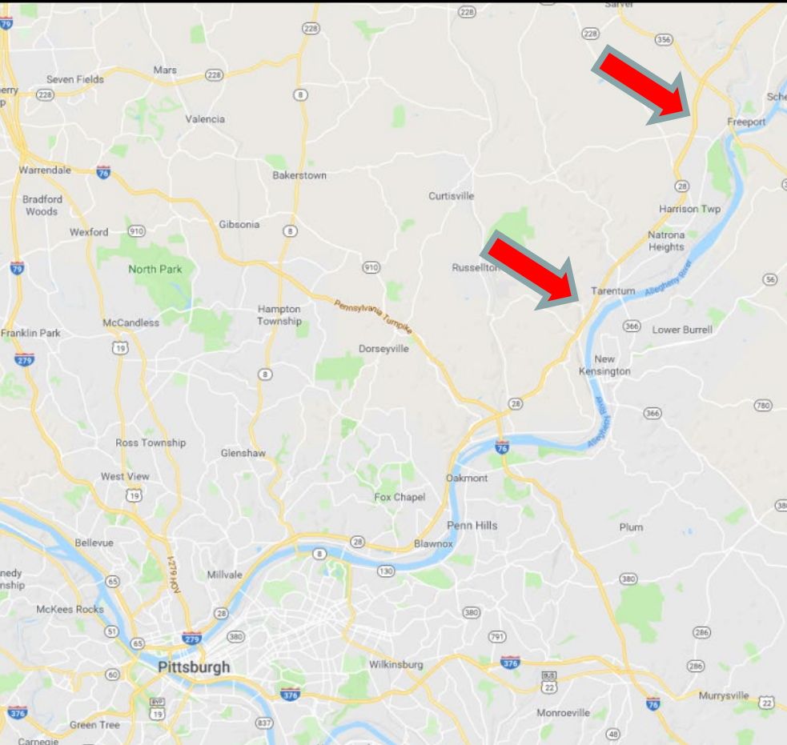
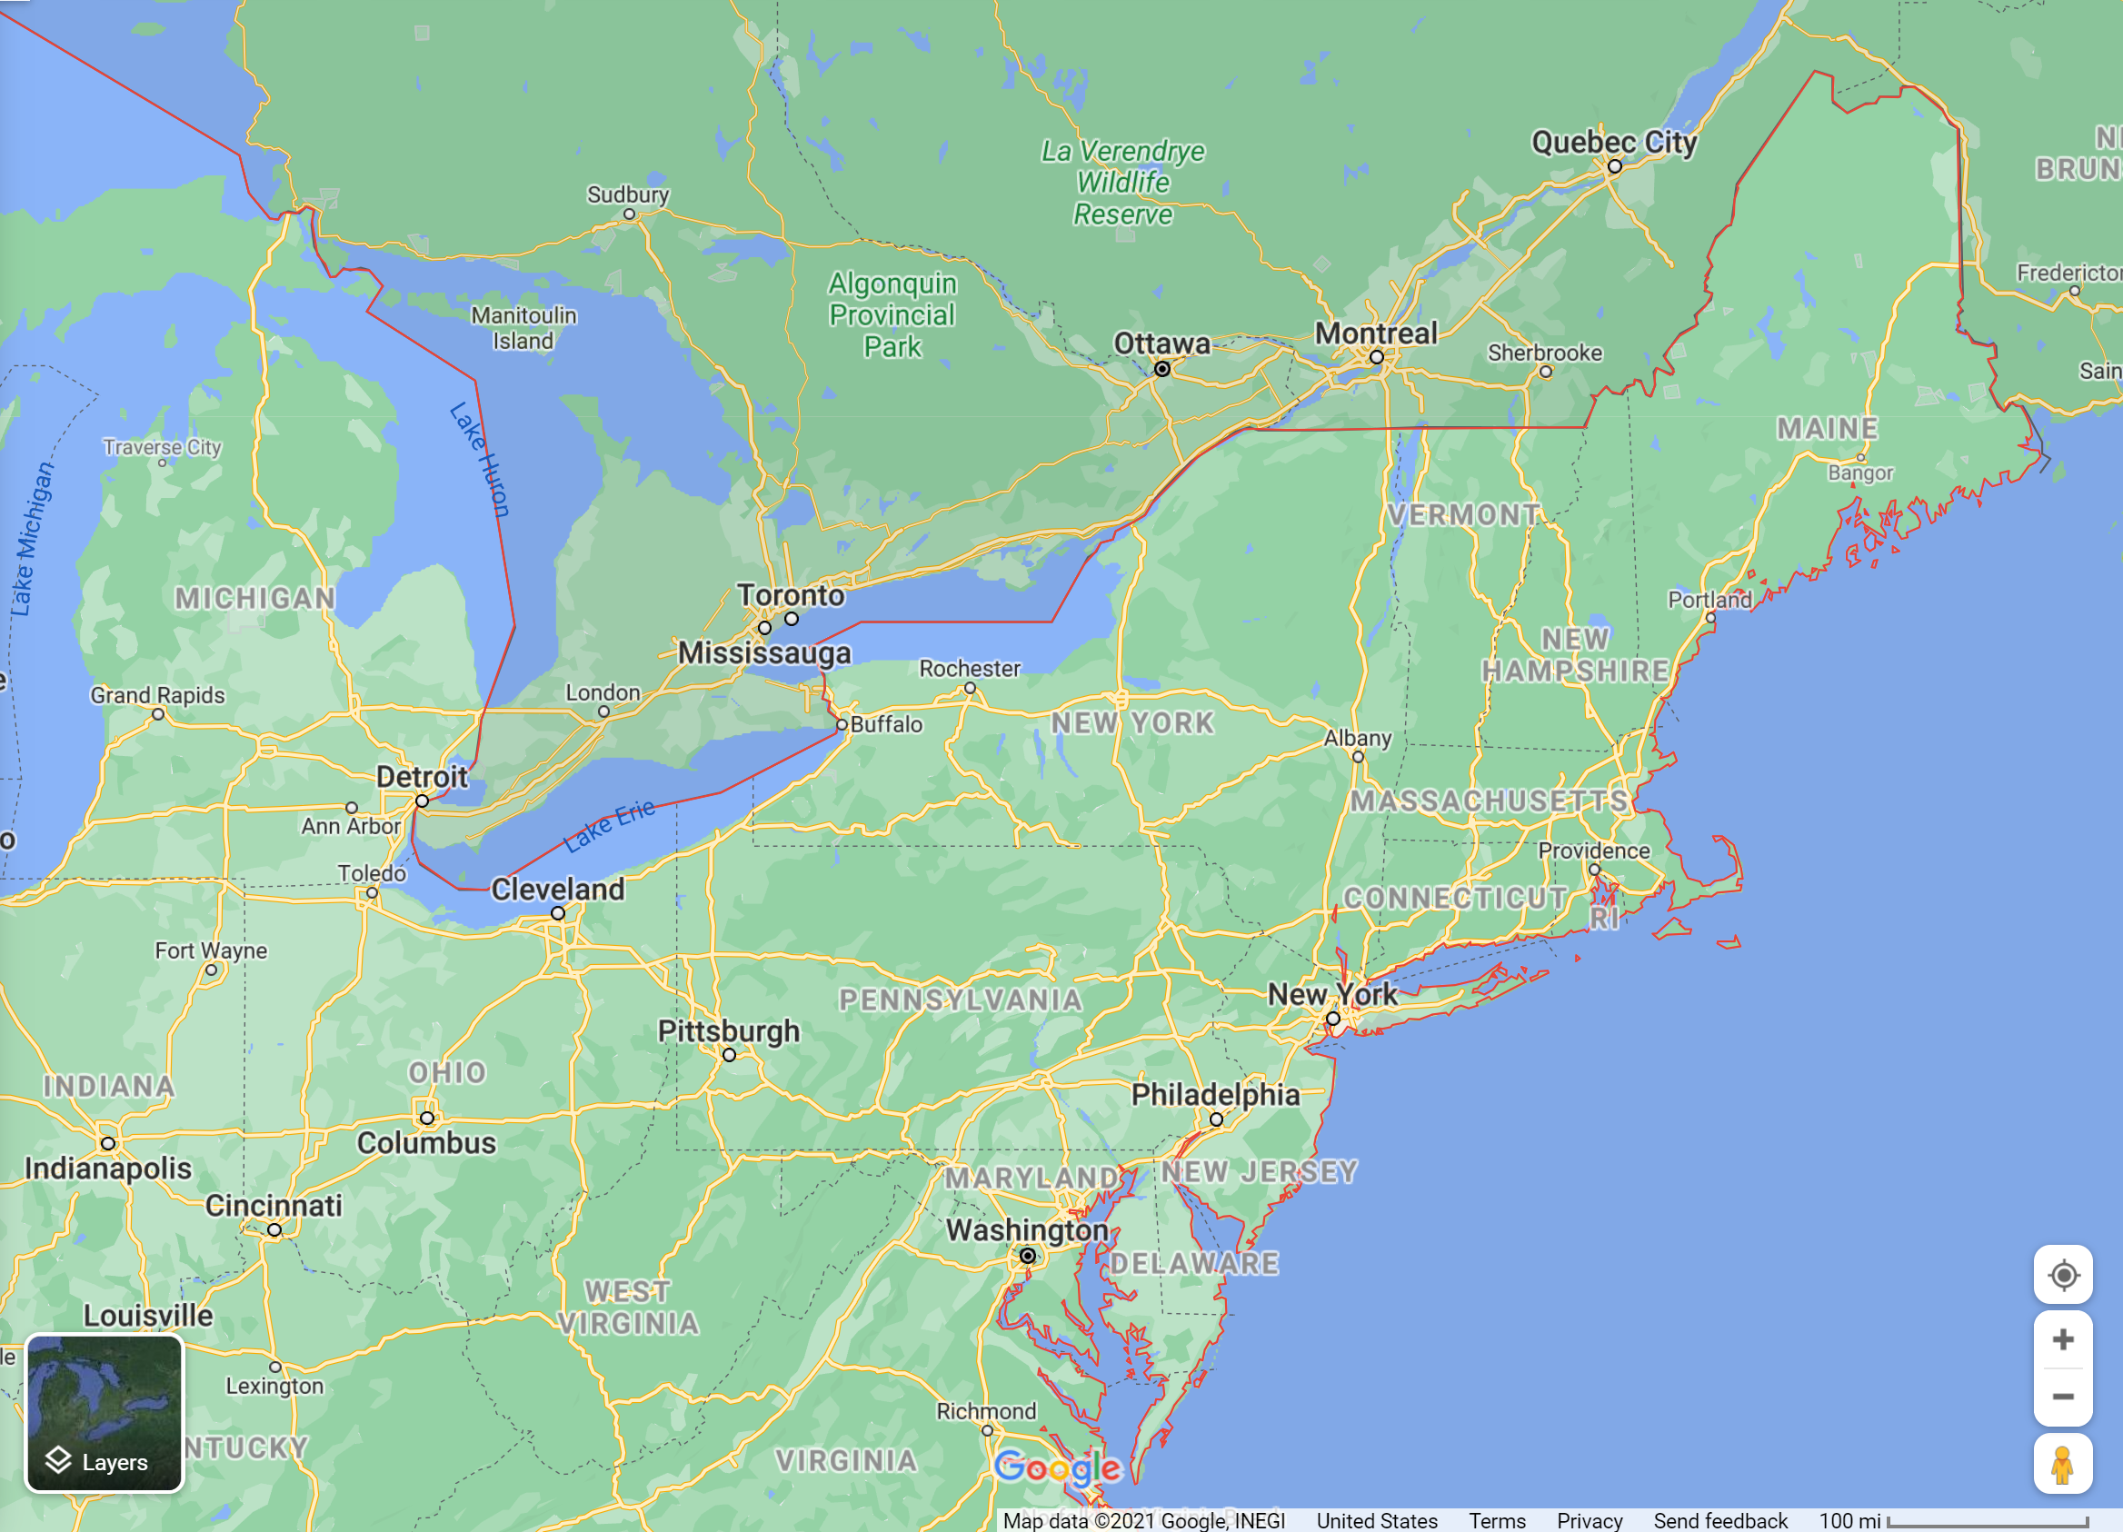
Location
13.7 miles of JRCP near Pittsburgh PA
Tom Adams – Formerly with PennDOT

Slide 8
Project history
1984 JRCP 25-ft doweled jts
2009 CPR
2004 CPR
2021 Break and Seat (35 yr design life)
Subgrade CBR 3 to 5
Tom Adams – Formerly with PennDOT

Slide 9
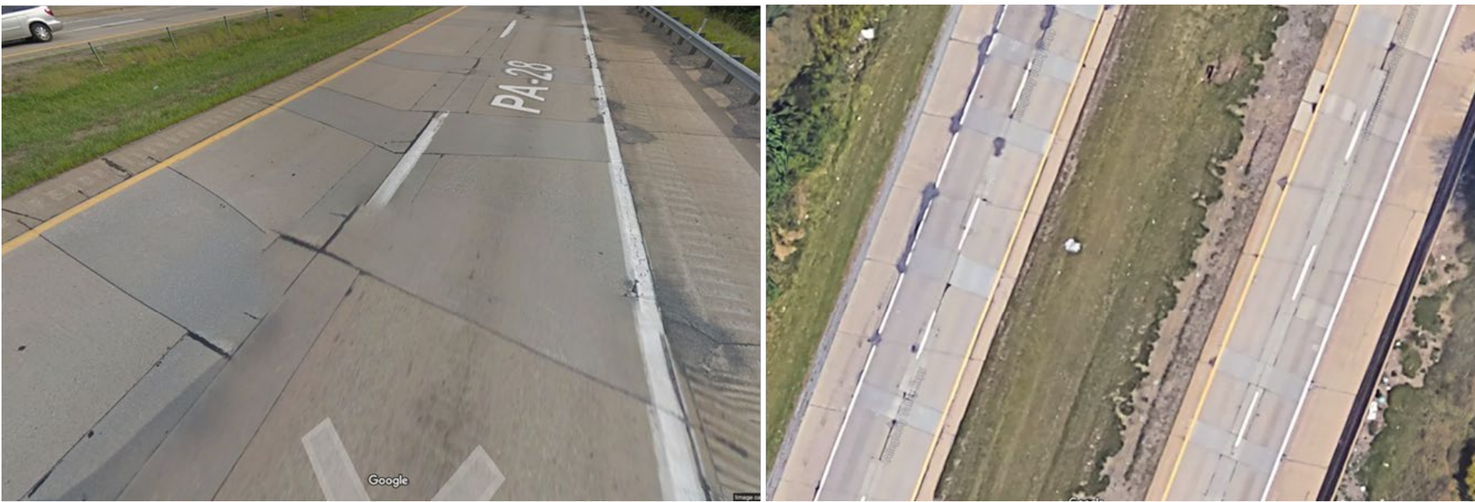
Project description
4-lane divided highway
Speed limit: 55 mph
Tom Adams – Formerly with PennDOT

Slide 10
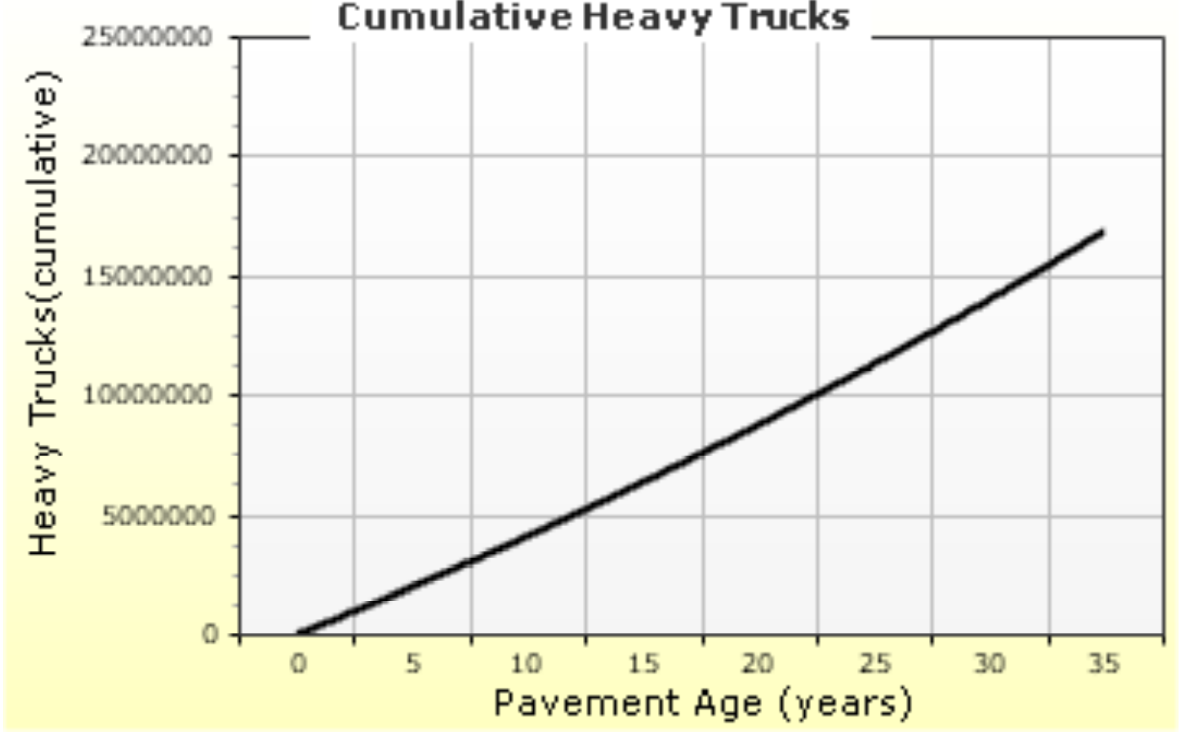
Traffic
Initial 2-way ADTT = 2,382
Trucks in design direction = 50%
# Lanes in design direction = 4
Trucks in design lane = 90 %
35-yr design traffic
12.38 million flexible ESALs
17 million heavy trucks

Slide 11
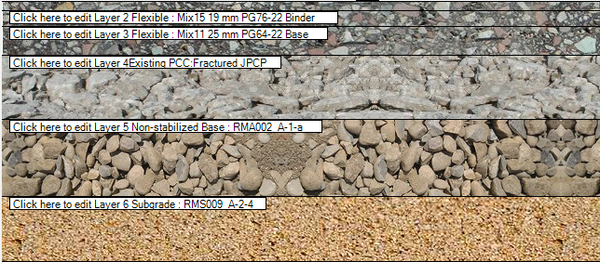
Current Structure
10 in - Break and Seat JRCP
12 in - 2A Dense graded subbase (A-1-a)
Subgrade A-2-4

Slide 12
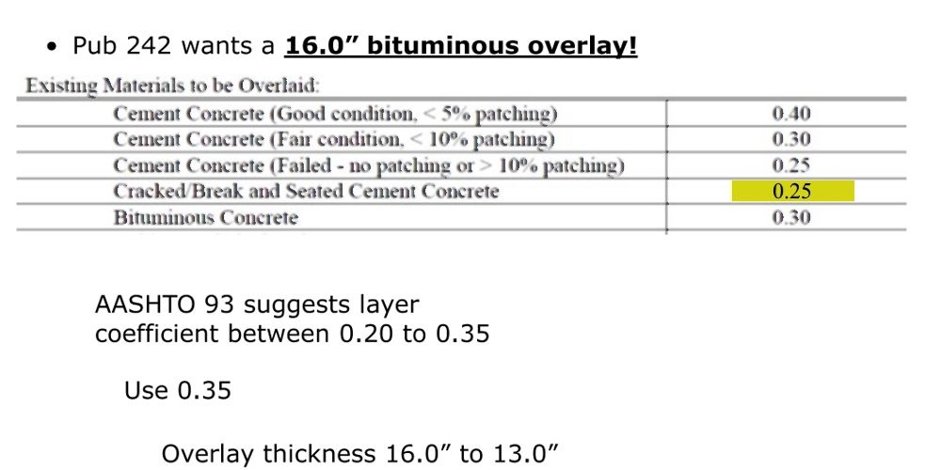
AASHTO ’93 Guide – Break and seat
Tom Adams – Formerly with PennDOT

Slide 13
AASHTO ’93 Gui – Break and seat de
Tom Adams – Formerly with PennDOT

Slide 14
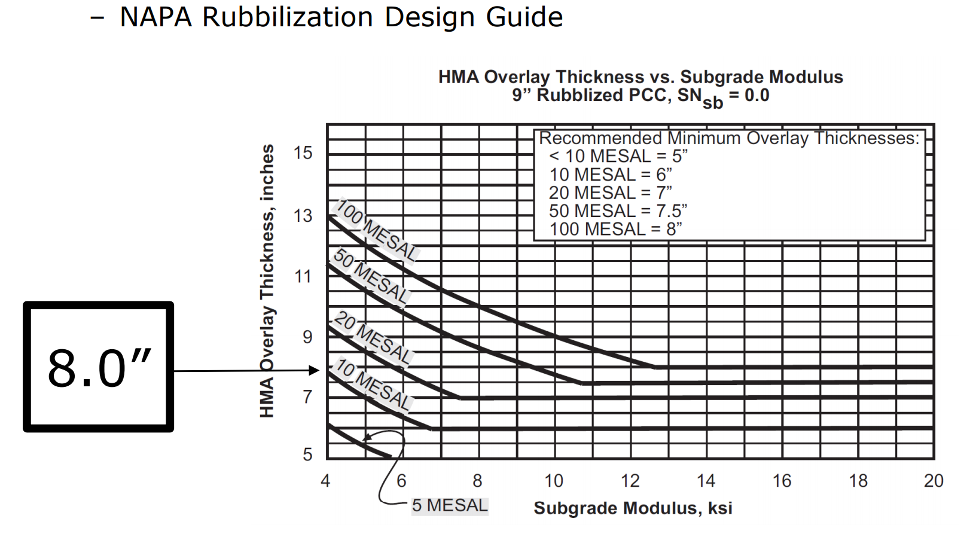
NAPA Rubblization Design Guide
Tom Adams – Formerly with PennDOT

Slide 15
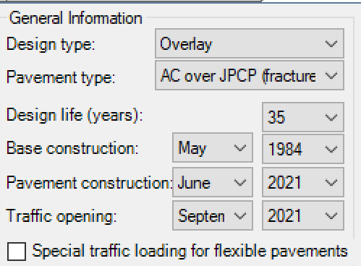
PaveME – General info.
Lydia Peddicord - PennDOT

Slide 16
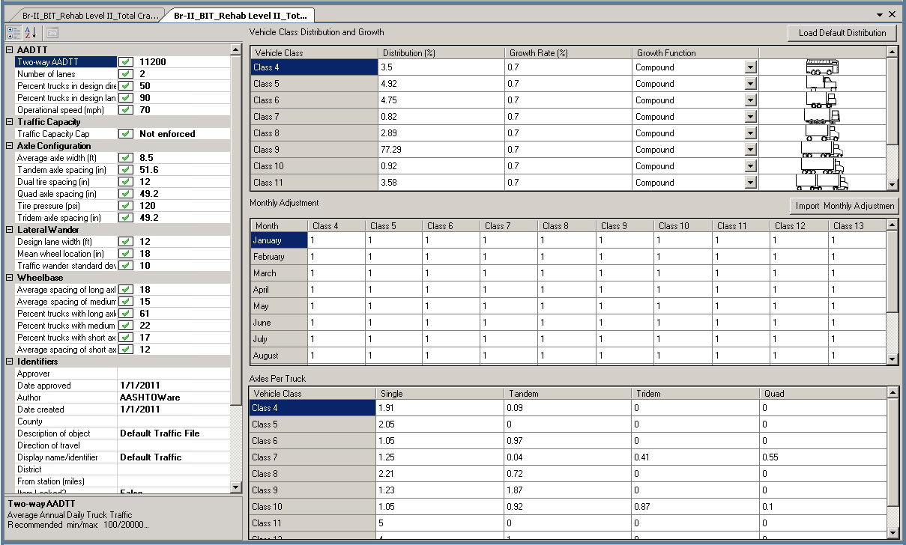
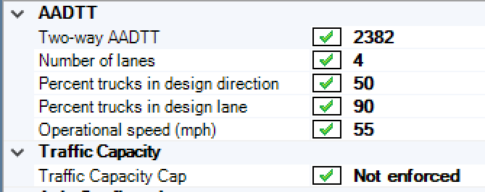
PaveME Inputs – Traffic
Lydia Peddicord - PennDOT

Slide 17
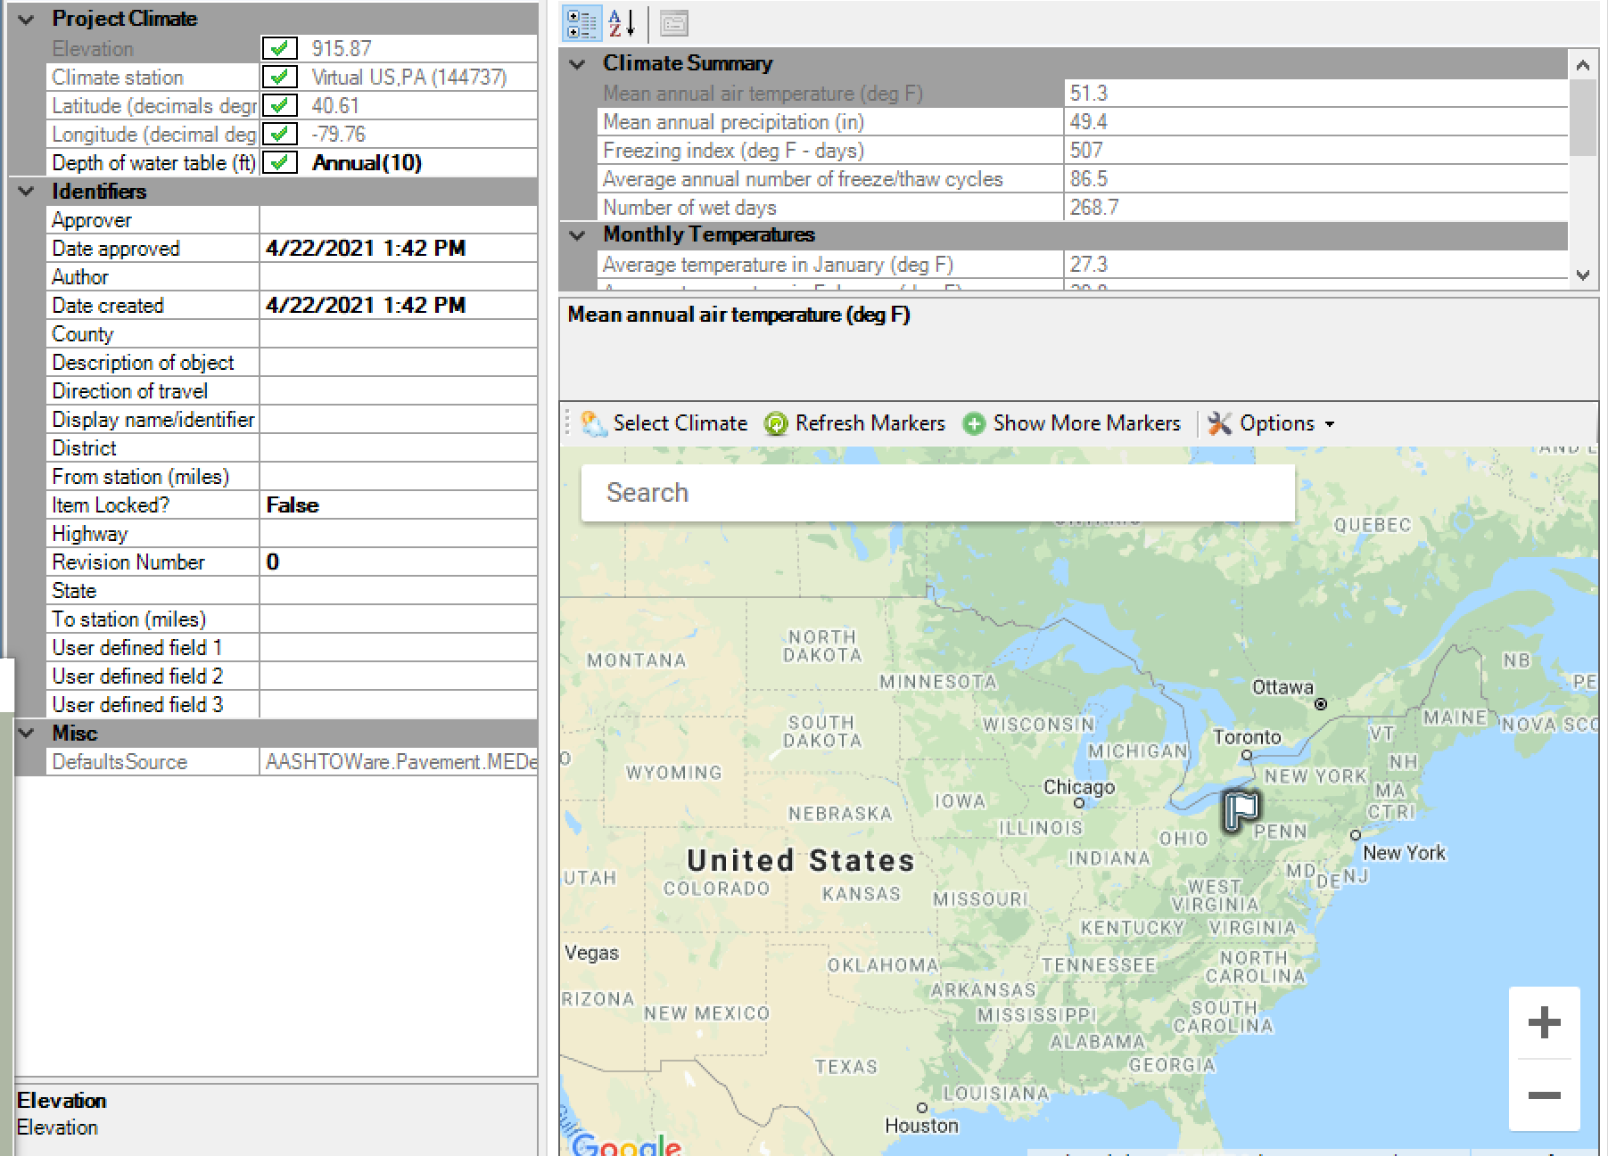
PaveME Inputs – Climate
Lydia Peddicord - PennDOT

Slide 18
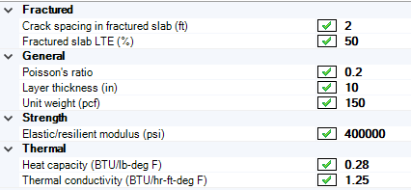
PaveME – Break and seat layer
Lydia Peddicord - PennDOT

Slide 19
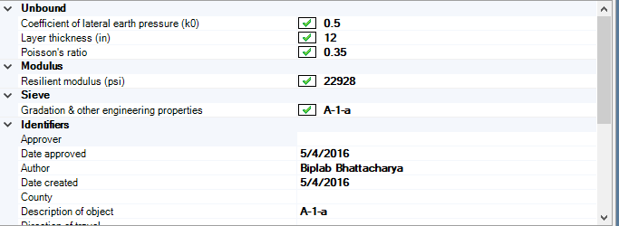
PaveME –2A Subbase
Lydia Peddicord - PennDOT

Slide 20
PaveME –Subgrade
Lydia Peddicord - PennDOT

Slide 21
Final Structure
8.5 in - HMA Overlay
1.5 in- Mix25 WM SMA 9.5 mm PG76-22 Wearing
2.5 in- Mix15 19 mm PG76-22 Binder
4.5 in- Mix11 25 mm PG64-22 Base
10 in- Break and Seat JRCP
12 in- 2A Dense graded subbase (A-1-a)
Subgrade A-2-4

Slide 22
PaveME – Predicted distress
Lydia Peddicord - PennDOT

Slide 23
Construction
Sawcut at 1/3 points to a depth sufficient to sever mesh reinforcing steel.
Guillotine breaker used in fracturing effort as per test section results
Typ. breaking pattern of 18 to 24 in apart
E_{back} = 400,000 to 900,000 psi (verify with FWD @ 9kip load)
Seat cracked pavement using 50-ton pneumatic tire roller (2 to 4 passes)
Greg Tomon – Lindy Paving

Slide 24
Construction - Guillotine breaker
Greg Tomon – Lindy Paving

Slide 25
Construction - FWD
Greg Tomon – Lindy Paving

Slide 26
Construction – Cracking pattern
Greg Tomon – Lindy Paving

Slide 27
Construction – Seating the cracked pavement
Greg Tomon – Lindy Paving

Slide 28
Construction- paving
Greg Tomon – Lindy Paving

Slide 29
Asphalt Overlay of Rubblization

Slide 30
PaveME - Rubblization
Design inputs associated with rubblization:
1. Design type: Select New Pavement/Flexible pavement
Rubblized Layer Recommended Ranges:
Subdivide into 2 layers (if needed, based on deflection data)
RMSE will indicated if 2 layers are needed
Unit weight: 140 -160 pcf
Poisson’s ratio = 0.3
Elastic modulus = 50,000 to 150,000 psi
(65,000 psi recommended if deflection data is not available)

Slide 31
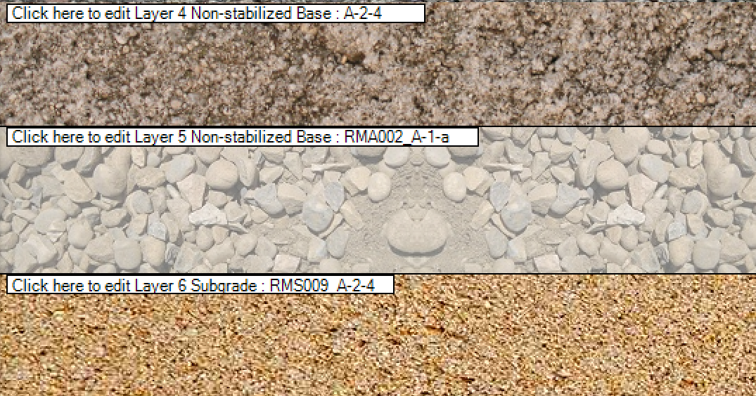
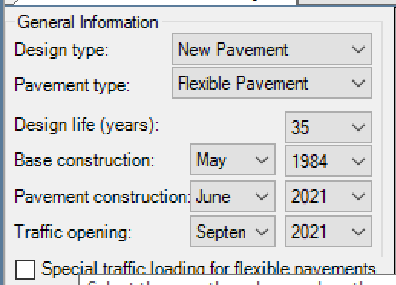
PaveME – General info.

Slide 32
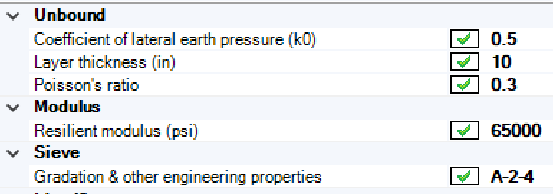
PaveME – Rubblized layer

Slide 33
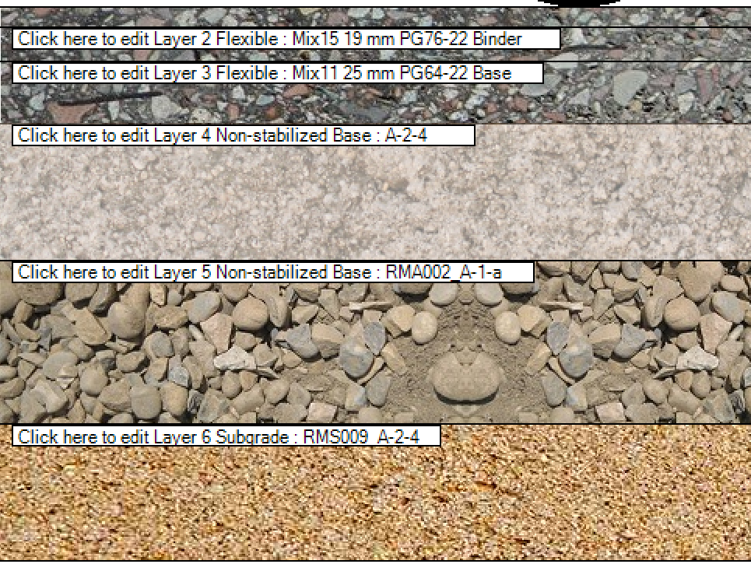
Final Structure
8.5 in - HMA Overlay
1.5 in- Mix25 WM SMA 9.5 mm PG76-22 Wearing
2.5 in- Mix15 19 mm PG76-22 Binder
4.5 in- Mix11 25 mm PG64-22 Base
10 in- Rubbilized JRCP
12 in- 2A Dense graded subbase (A-1-a)
Subgrade A-2-4

Slide 34
PaveME – Predicted distress

Slide 35
QUESTIONS?

